Slide 1

CIS017-1 – Computer Systems Structure CIS095-1 – Databases and Computer Networking
Lecture – Database Structures and Entity Relationship Models

Slide 2
What is Data? - Dates, values, names etc…
What is Information?
Is data that is given context, and therefore meaning
Information is about relationships between different bits of data
What is a Database? - Collection of related data
What is a DBMS? - Database Management System (DBMS) is the software that manages and controls access to the database
Examples: MS Access, Oracle SQL, mySQL, etc

Slide 3
The Database Management System (DBMS)
A software system that enables users to define, create, maintain, and control access to the database.
Data Definition Language(DDL)
Data Manipulation Language (DML)
Views
Level of security, customization, provide consistent structure
Notes:
DDL allows users to specify the data types and structures, and the constraints on the data to be stored in the database
DML allows users to insert, update, delete and retrieve data from the database.

Slide 4

Components of a DBMS environment
Hardware
Client-server architecture
Backend, front end
Software
DBMS, application programs, SQL
Data
Operational data, meta data
Procedure
Instructions and rules
People

Slide 5
Data Capture
Database developers normally use several fact-finding techniques during a single database project including:
examining documentation,
interviewing,
observing organization in operation,
research,
questionnaires.

Slide 6
Database Application Lifecycle
Database planning
System definition
Requirements collection and analysis
Database design
DBMS selection (optional)

Slide 7
Database Application Lifecycle (contd..)
Application design
Prototyping (optional)
Implementation
Testing
Operational maintenance

Slide 8
1) Database Planning
Mission statement - defines major aims of database application
Mission statement helps clarify purpose of the database project and provides clearer path towards the efficient and effective creation of required database application.
Database planning should also include development of standards that govern:
how data will be collected,
how the format should be specified,
what necessary documentation will be needed,
how design and implementation should proceed

Slide 9
2) System Definition
Describes scope and boundaries of database application and the major user views.
User view
Job role
Application area (such as marketing, personnel, or stock control).

Slide 10
3) Requirements Collection and Analysis
Process of collecting and analyzing information
Uses this information to identify users’ requirements of new system.

Slide 11
4) Database Design
Represent data and relationships between data required by all major application areas and user groups.
Each user’s perspective of the data
Building data model requires answering questions about entities, relationships, and attributes.

Slide 12
Three Phases of Database Design
Conceptual database design (ERD)
Data model is built using the information in users’ requirements specification.
Source of information for logical design phase.
Logical database design
Conceptual data model is refined and mapped on to a logical data model.
Physical database design
Describes storage structures and access methods used to achieve efficient access to data.
Tailored to a specific DBMS system.

Slide 13
5) DBMS Selection
Selection of an appropriate DBMS to support the database application.
What are we using ?
Why?

Slide 14
6) Application Design
Design of user interface and application programs that use and process the database.
Database and application design are parallel activities.

Slide 15
7) Implementation
Physical realization of the database and application designs
Use DDL to create database schemas and empty database files
Use 3GL or 4GL to create the application programs. This will include the database transactions implemented using the DML, possibly embedded in a host programming language.
Notes:
A fourth-generation programming language (1970s-1990) (abbreviated 4GL) is a programming language or programming environment designed with a specific problem domain or set of design patterns in mind, such as the development of commercial business software.
A third-generation programming language (3GL) is a refinement of a second-generation programming language. The second generation of programming languages brought logical structure to software. The third generation brought refinements to make the languages more programmer-friendly. This includes features like improved support for aggregate data types, and expressing concepts in a way that favours the programmer, not the computer (e.g. no longer needing to state the length of multi-character (string) literals in Fortran). A third generation language improves over a second generation language by having the computer take care of non-essential details, not the programmer. "High level language" is a synonym for third-generation programming language.
Data Definition Language (DDL) statements are used to define the database structure or schema. Some examples:
CREATE-Objects in the database
ALTER - alters the structure of the database
DROP - delete objects from the database
TRUNCATE - remove all records from a table, including all spaces allocated for the records are removed
COMMENT - add comments to the data dictionary
RENAME - rename an object
Data Manipulation Language (DML) statements are used for managing data within schema objects. Some examples:
SELECT - retrieve data from the a database
INSERT - insert data into a table
UPDATE - updates existing data within a table
DELETE - deletes all records from a table, the space for the records remain
MERGE - UPSERT operation (insert or update)
CALL - call a PL/SQL or Java subprogram
EXPLAIN PLAN - explain access path to data
LOCK TABLE - control concurrency

Slide 16
8) Testing
Process of executing application programs with intent of finding errors.
Use carefully planned test strategies and realistic data.
Testing cannot show absence of faults; it can show only that software faults are present.
Demonstrates that database and application programs appear to be working according to requirements.

Slide 17
9) Operational Maintenance
Process of monitoring and maintaining system following installation.
Monitoring performance of system.
if performance falls, may require tuning or reorganization of the database.
Maintaining and upgrading database application (when required).
Incorporating new requirements into database application.

Slide 18
Entity Relationship Modelling
Part II

Slide 19
How to use Entity–Relationship (ER) modelling in database design.
Basic concepts associated with ER model.
How to identify and resolve problems with ER models called connection traps.
How to build an ER model from a requirements specification.

Slide 20
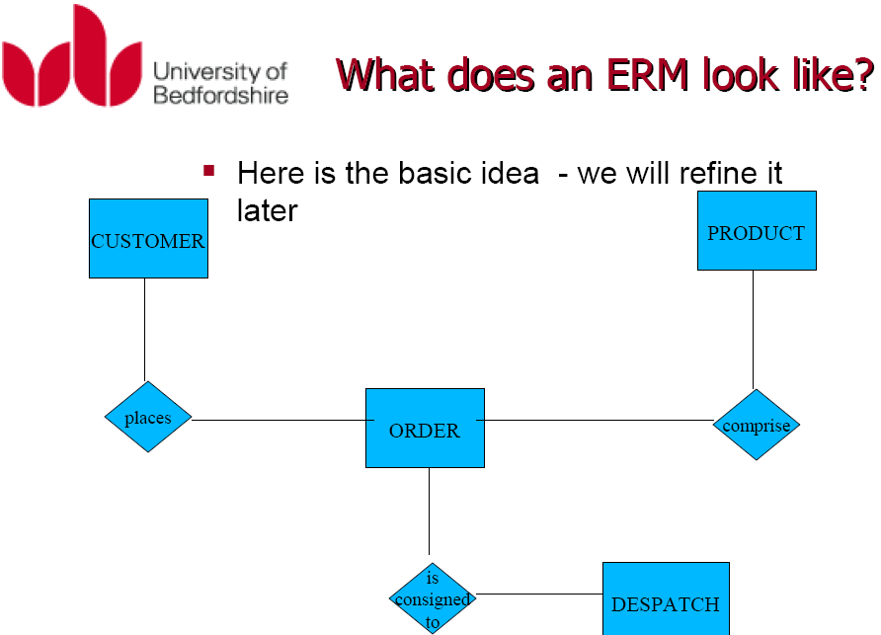

Slide 21
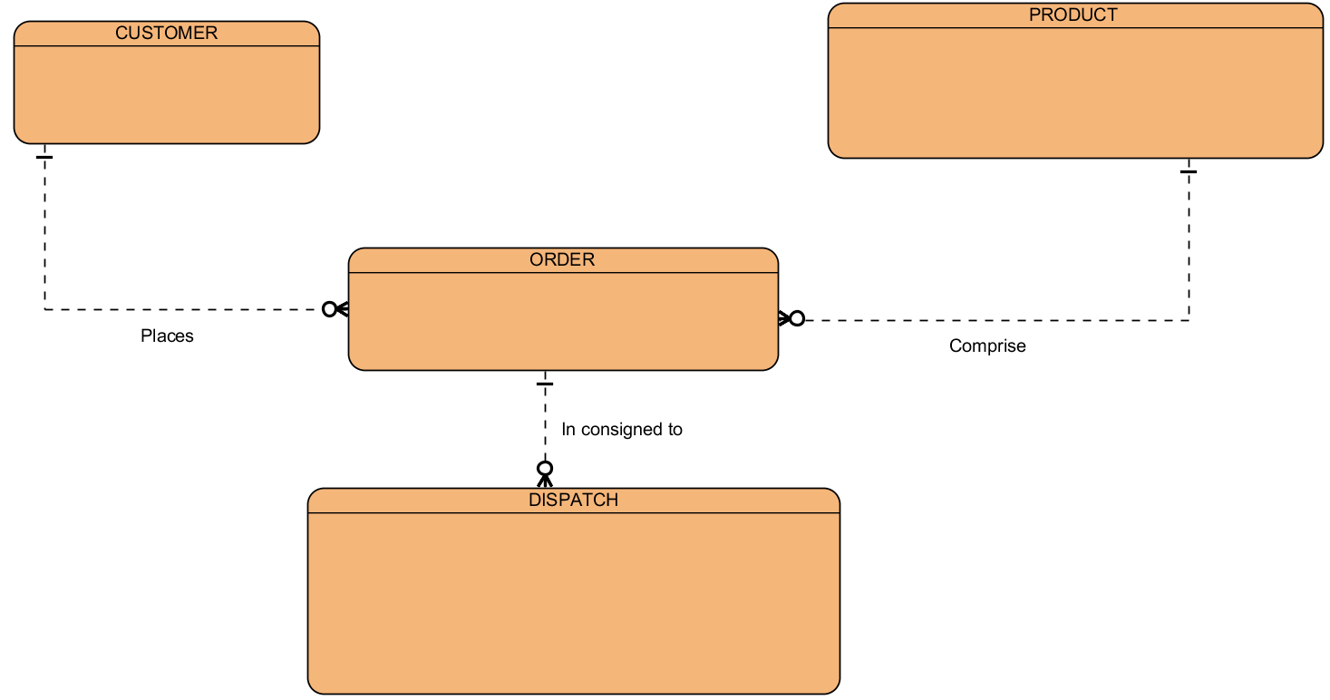
Alternate Notation

Slide 22
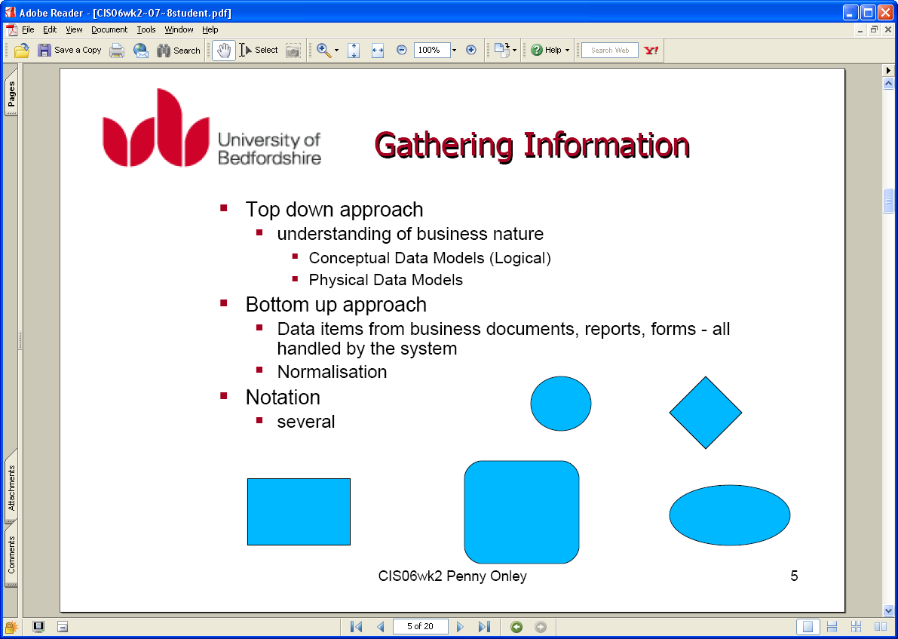

Slide 23
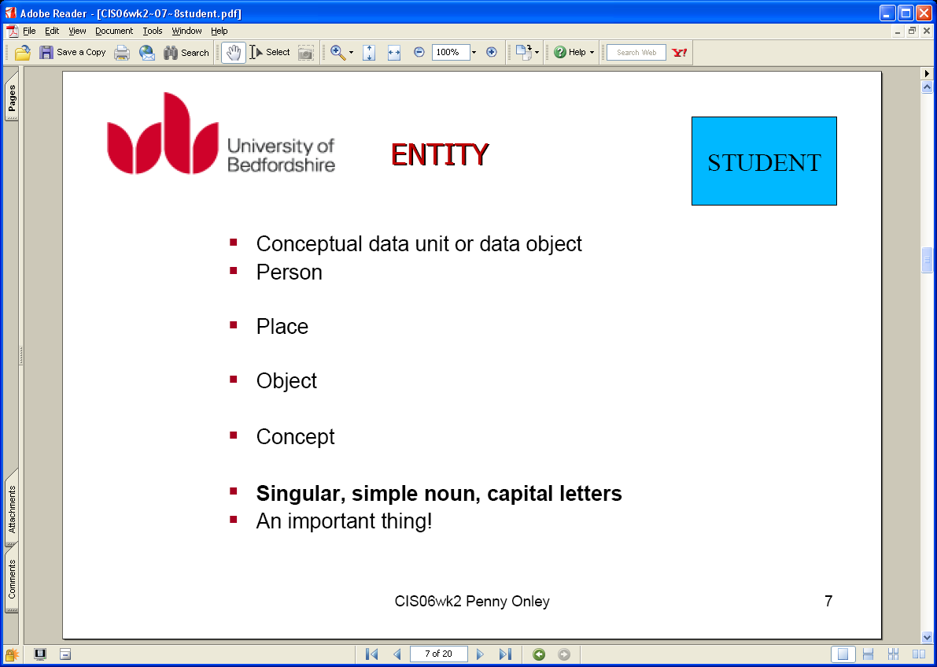

Slide 24
The Entity Relational Model
Entity Modelling – System Developer View
Undertaken independently
Remove inconsistencies
Tests before more detailed design
Structure of data represented graphically with the following simple elements
Entity Sets
Attributes
Relationships

Slide 25
Concept of ER Model
Entity types
Relationship types
Attributes

Slide 26
Entity Type
Strong Entity Type
Entity type that is not existence-dependent on some other entity type.
Weak Entity Type
Entity type that is existence-dependent on some other entity type.

Slide 27
Attributes
Attribute
Property of an entity or a relationship type.
Attribute Domain
Set of allowable values for one or more attributes.

Slide 28
Attributes
Simple Attribute
Attribute composed of a single component with an independent existence.
Composite Attribute
Attribute composed of multiple components, each with an independent existence.
Notes:
Composite attribute -name

Slide 29
Attributes
Single-valued Attribute
Attribute that holds a single value for each occurrence of an entity type.
Multi-valued Attribute
Attribute that holds multiple values for each occurrence of an entity type.
Notes:
Telephone number for a branch – multi valued attribute

Slide 30
Attributes
Derived Attribute
Attribute that represents a value that is derivable from value of a related attribute, or set of attributes, not necessarily in the same entity type.
Notes:
Total number of staff - Derived attribute

Slide 31
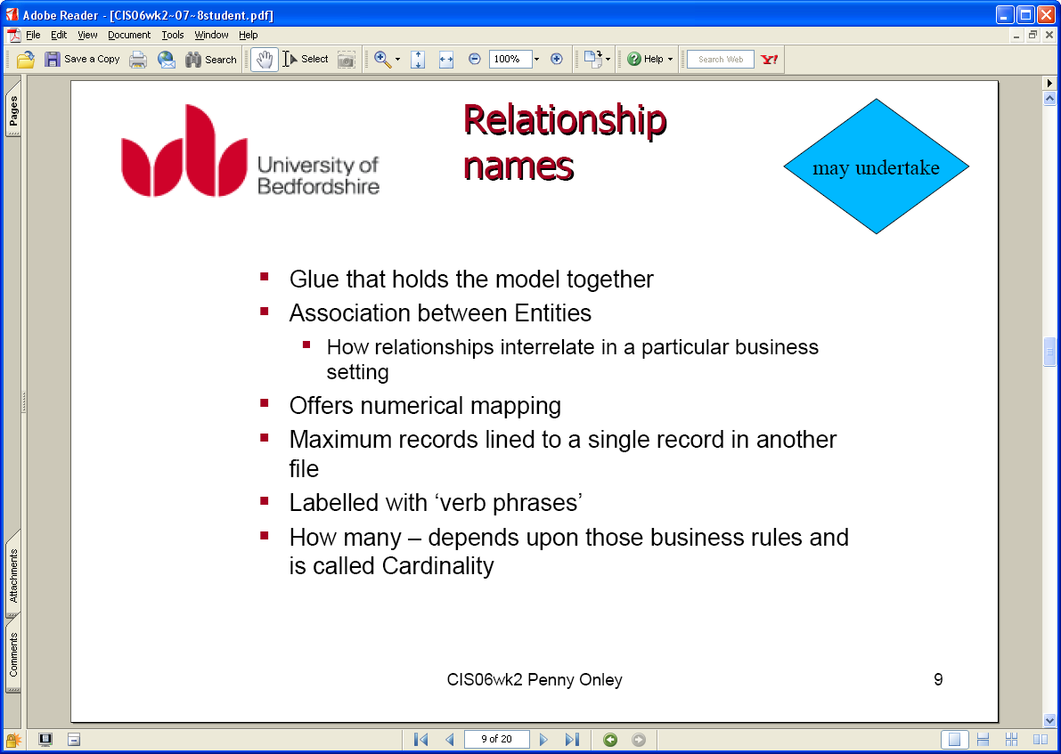
Notes:
Binary, ternary, quaternary

Slide 32
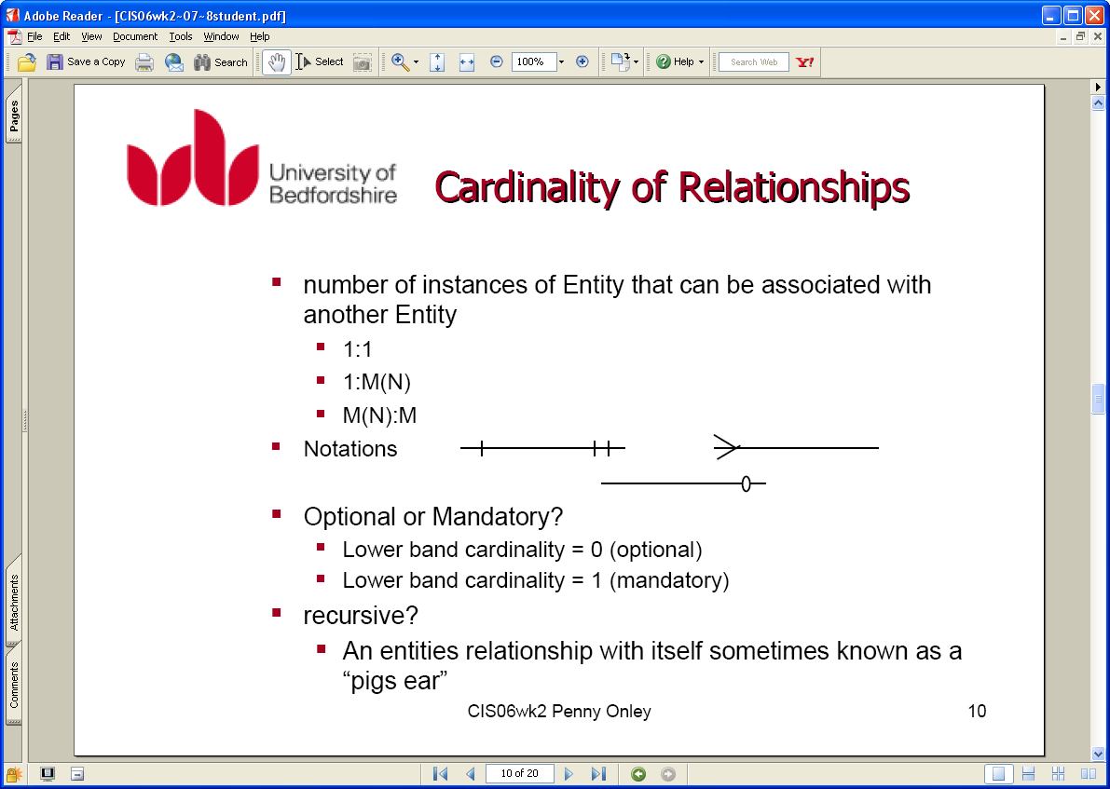

Slide 33
Keys
Candidate Key
Minimal set of attributes that uniquely identifies each occurrence of an entity type.
Primary Key
Candidate key selected to uniquely identify each occurrence of an entity type.
Composite Key
A candidate key that consists of two or more attributes.
Notes:
Candidate key is an attribute that uniquely identifies individual occurrences of an entity type. E.g Branch No
Primary key- the candidate selected to be the primary key e.g staff No and National Insurance number
Composite key – A candidate key that consists of two or more attributes.

Slide 34
Primary Key (EX)
staffNo, name, position salary, totalStaff
branchNo, address {street, city, zip code, telephone number[1..3]}
Patient number, patient name, drug number, drug name, description, dosage, method of admin, units per day, start date, finish date.

Slide 35
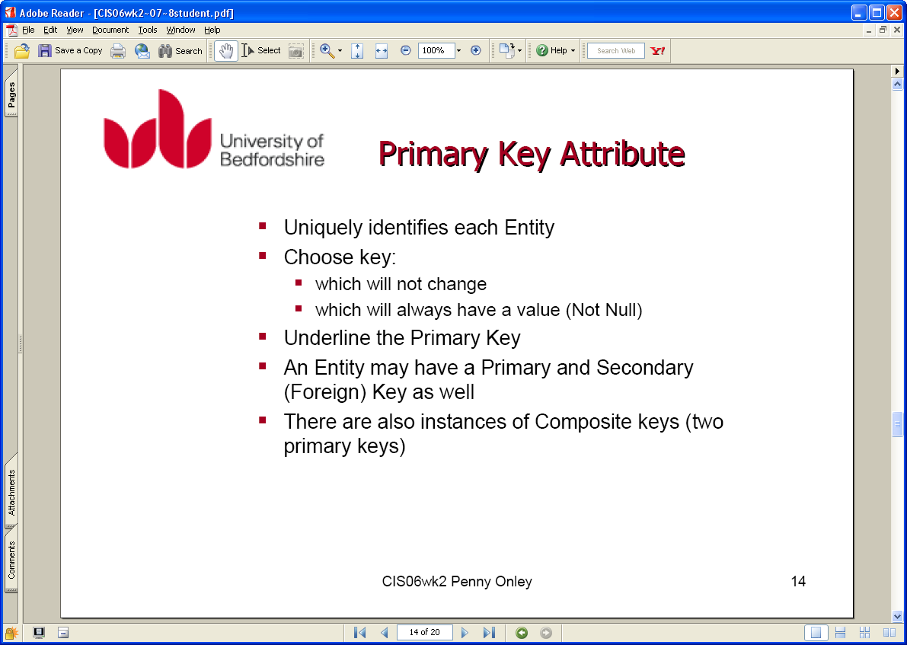

Slide 36
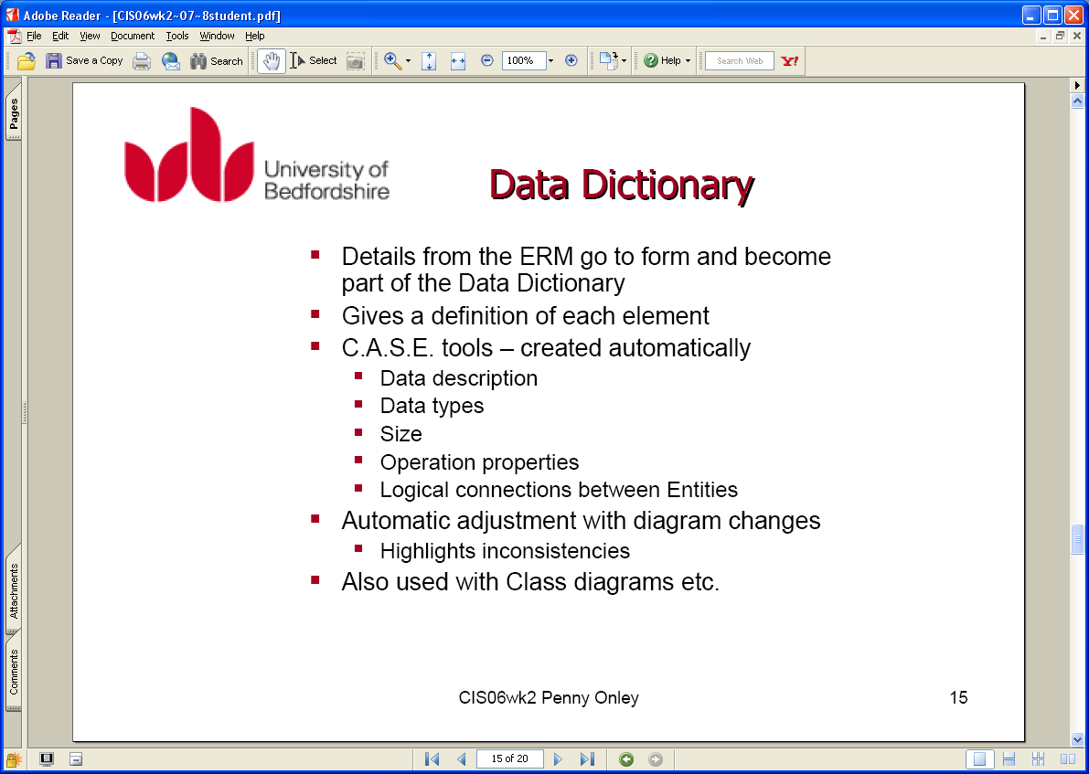
Notes:
C A S E – Computer Aided Software Engineering

Slide 37
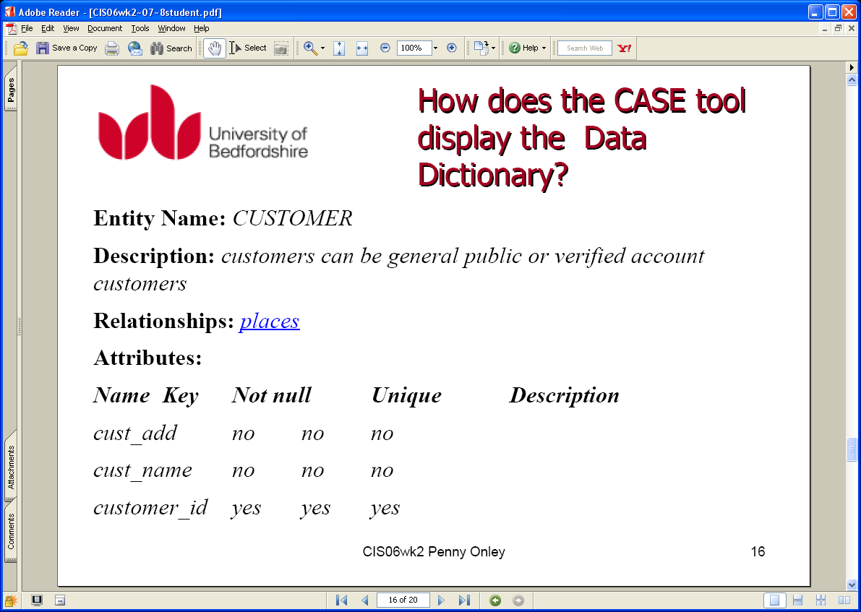

Slide 38
Structural Constraints
Main type of constraint on relationships is called multiplicity.
Multiplicity - number (or range) of possible occurrences of an entity type that may relate to a single occurrence of an associated entity type through a particular relationship.

Slide 39
Structural Constraints
The most common degree for relationships is binary.
Binary relationships are generally referred to as being:
one-to-one (1:1)
one-to-many (1:*)
many-to-many (*:*)

Slide 40
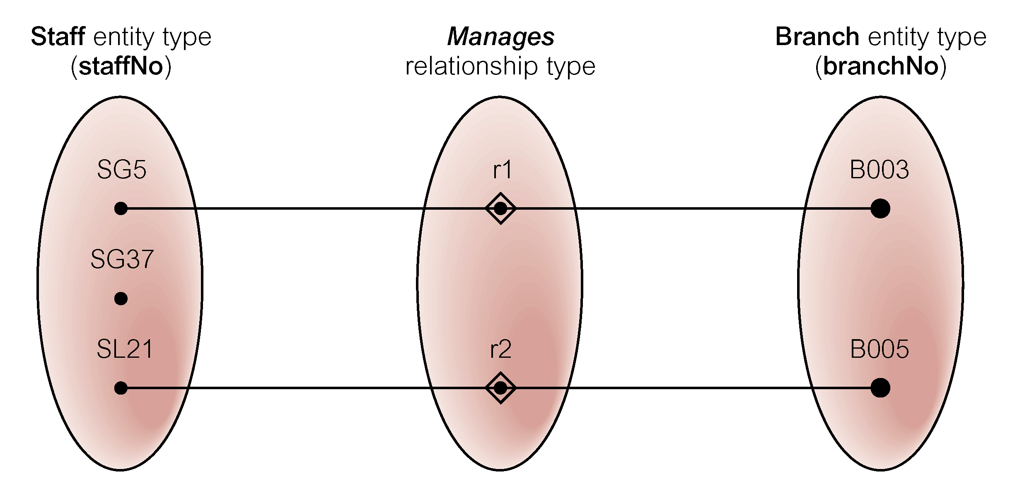
Semantic Net of Staff Manages Branch Relationship Type

Slide 41
Multiplicity of Staff Manages Branch (1:1) Relationship Type
Staff_No
Branch_No
Manages
Staff
1
1
Branch

Slide 42
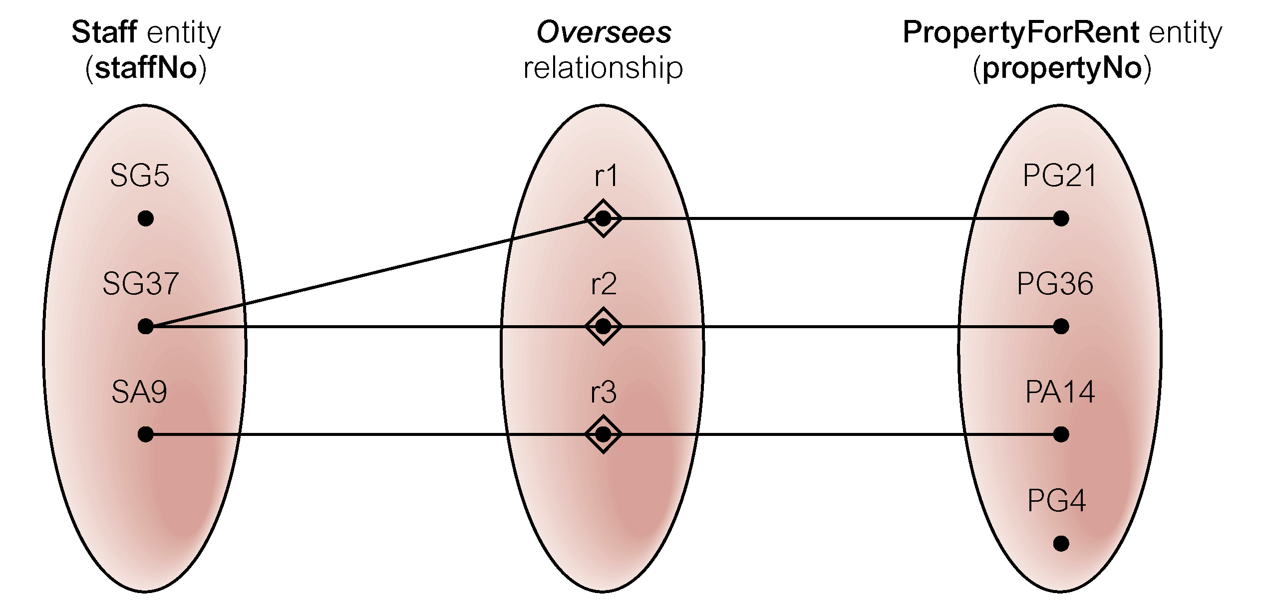
Semantic Net of Staff Oversees PropertyForRent Relationship Type
one-to-many (1:*)

Slide 43
Multiplicity of Staff Oversees PropertyForRent (1:*) Relationship Type
Staff_No
Property_No
Oversees
Staff
1
M
Property_for_rent
1:* or 1:M

Slide 44
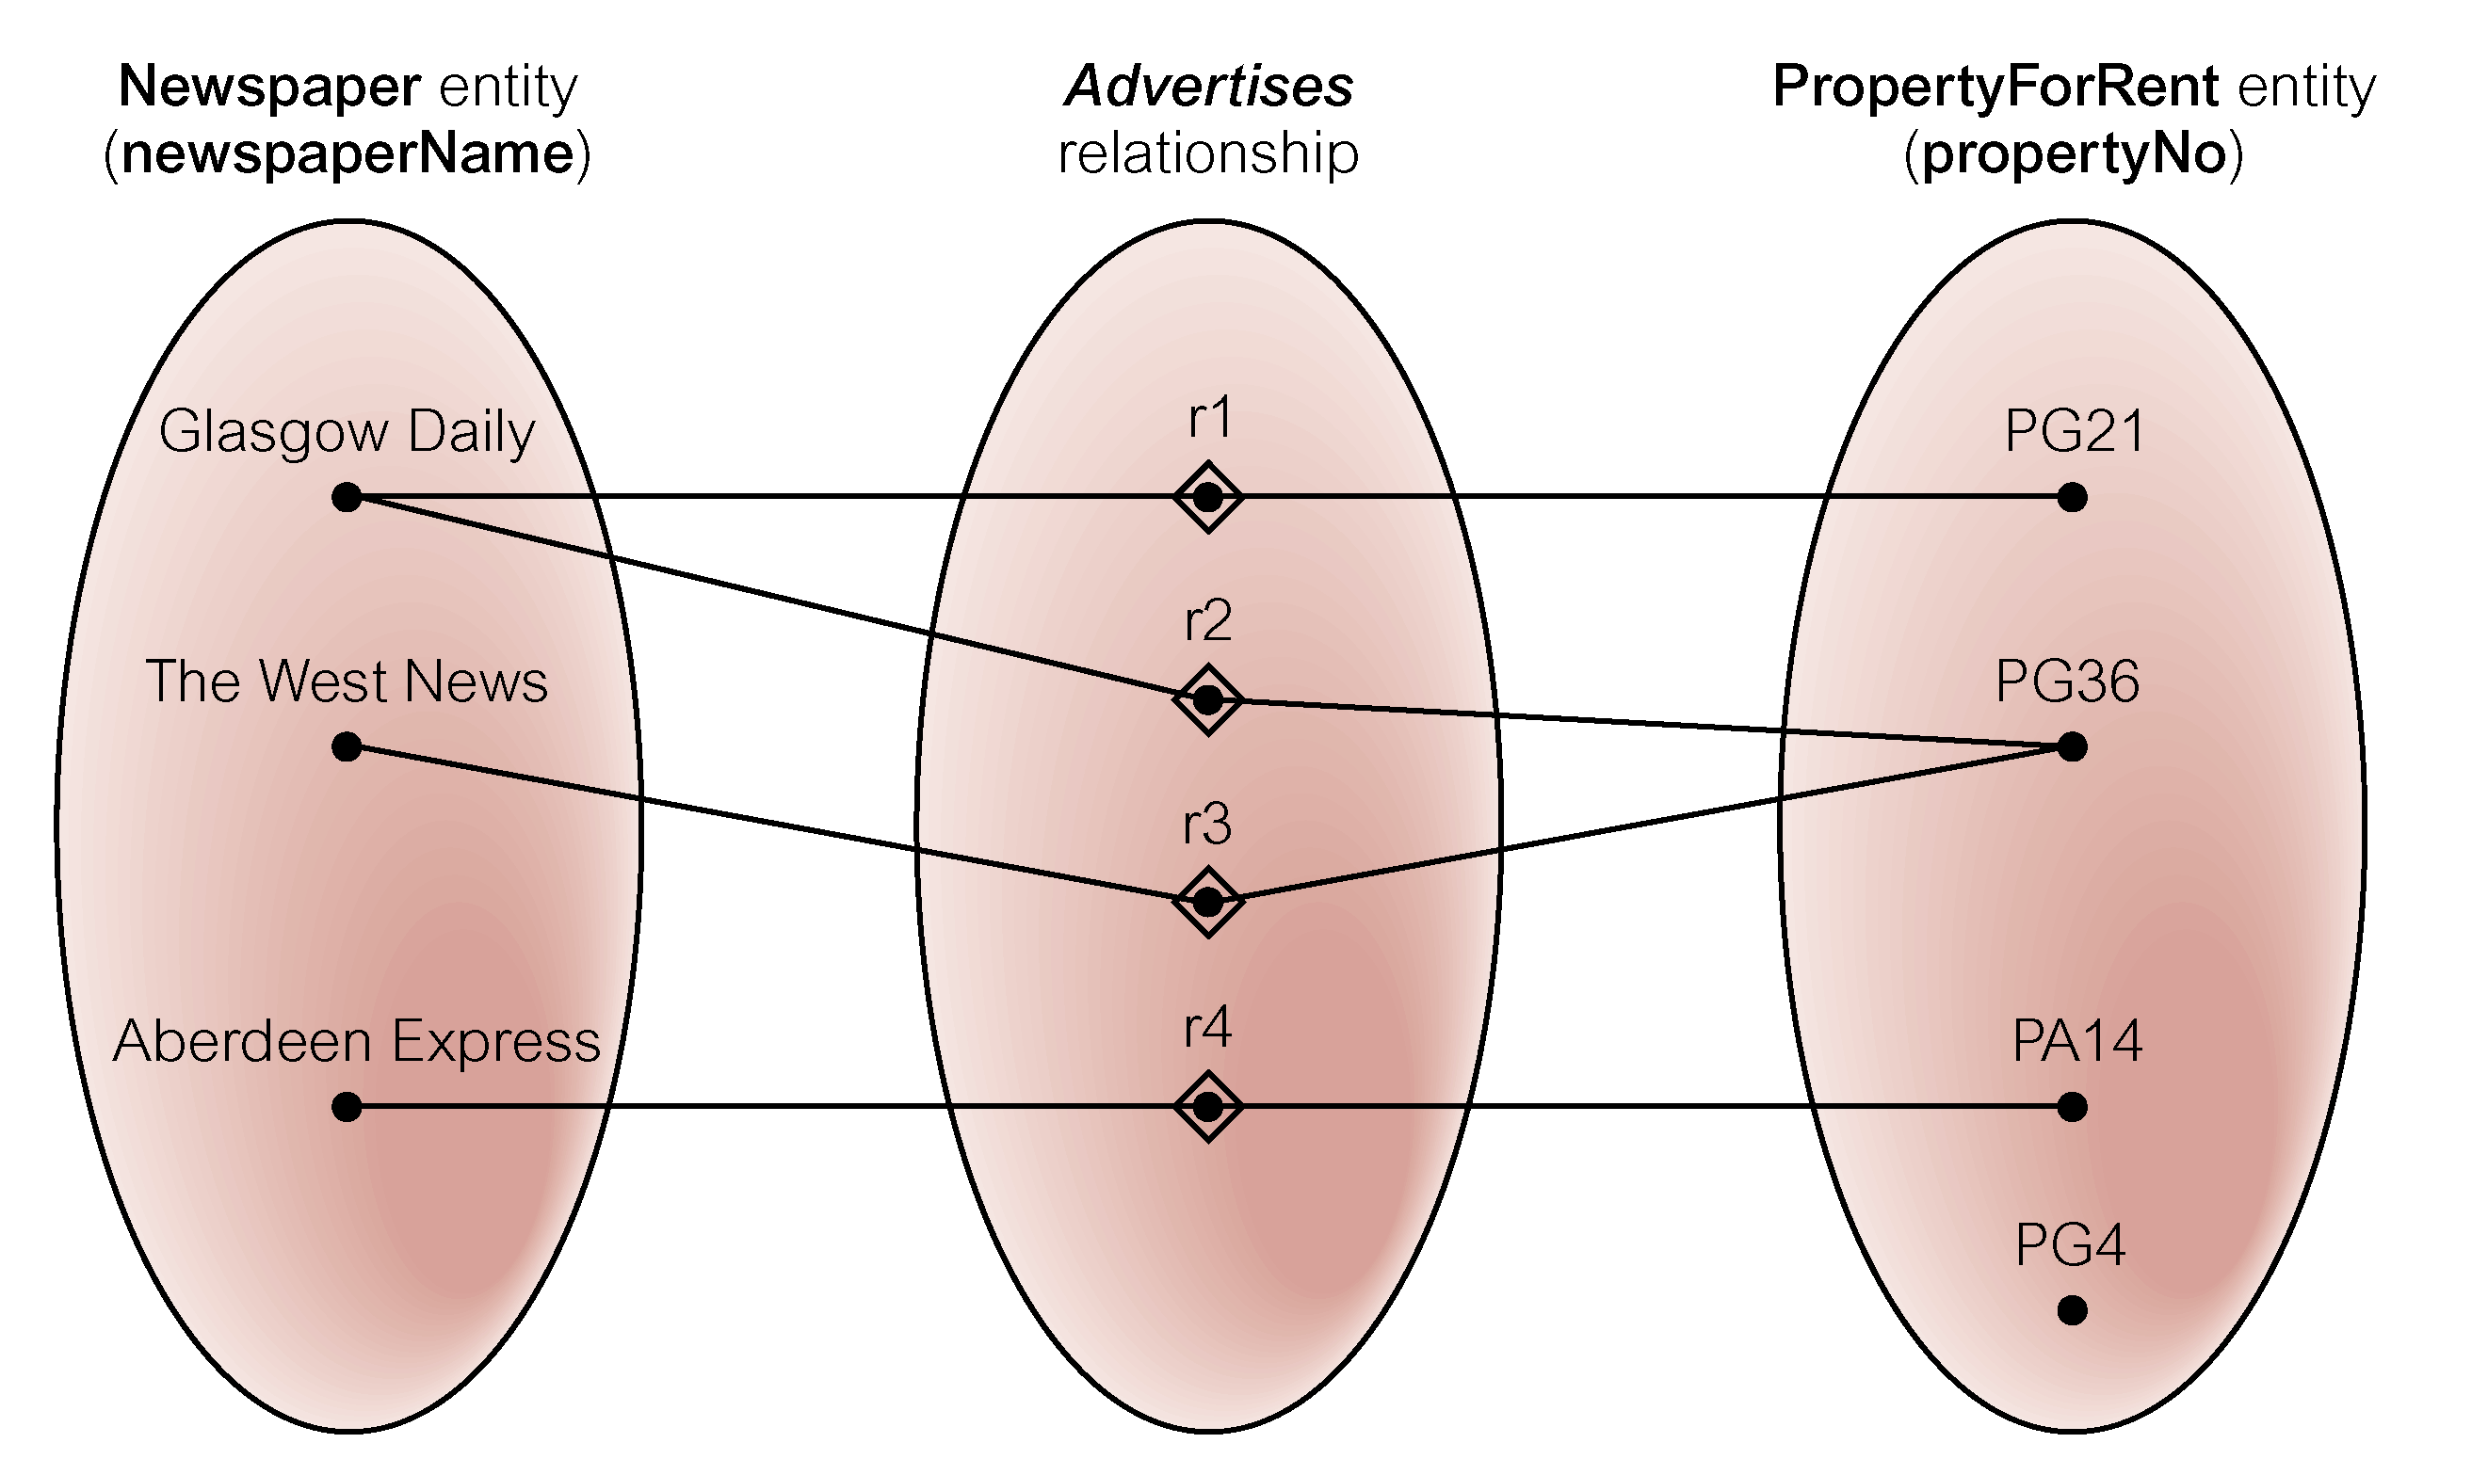
Semantic Net of Newspaper Advertises PropertyForRent Relationship Type
many-to-many (*:*)

Slide 45
Multiplicity of Staff Oversees PropertyForRent (*:*) Relationship Type
Newspaper_name
Property_No
Advertises
Newspaper
M
N
Property_for_rent

Slide 46
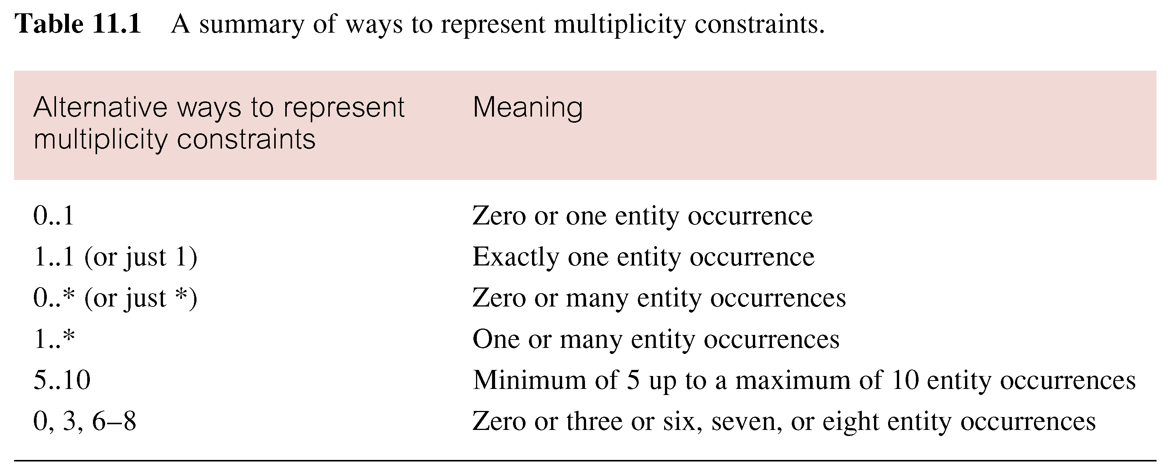
Summary of Multiplicity Constraints

Slide 47
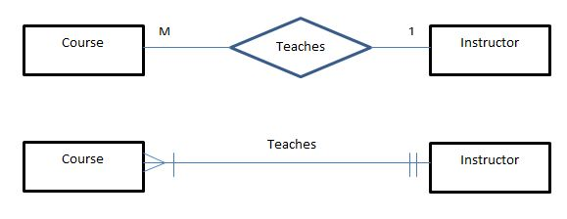
Alternate notations

Slide 48
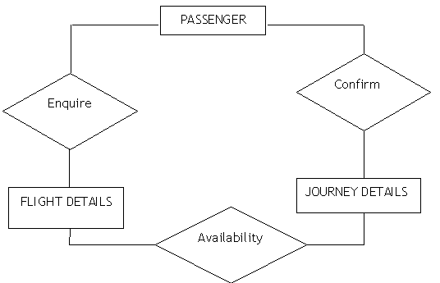
Simplified (No Attributes)

Slide 49
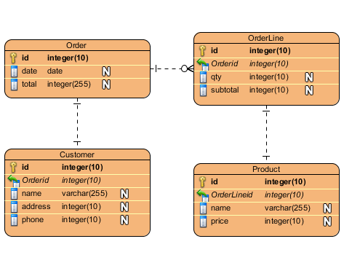
UML Style (Attributes inside Entities)

Slide 50
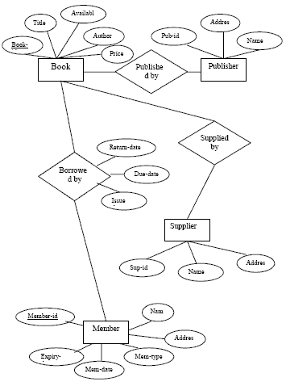

Slide 51
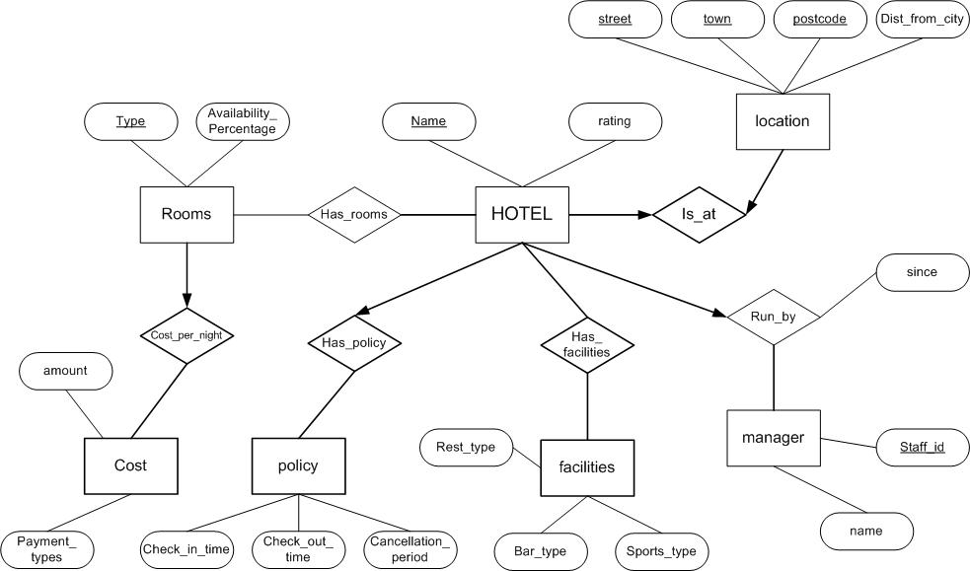

Slide 52
References
Thomas Connolly, Carolyn Begg, (2001) “Database Systems: A Practical Approach to Design, Implementation, and Management” 3rd Ed., ISBN: 0201708574, Addison Wesley
http://i.stack.imgur.com/thblX.jpg
http://www.visual-paradigm.com/VPGallery/img/datamodeling/EntityRelationshipDiagram/Entity-Relationship-Diagram-Sample.png
http://1.bp.blogspot.com/_FKQkgTHVLFA/TECjU1j3m0I/AAAAAAAAAAk/TVIUJNl2-sk/s1600/Entity_Relationship_Diagram_v001.jpg

